Slide 1
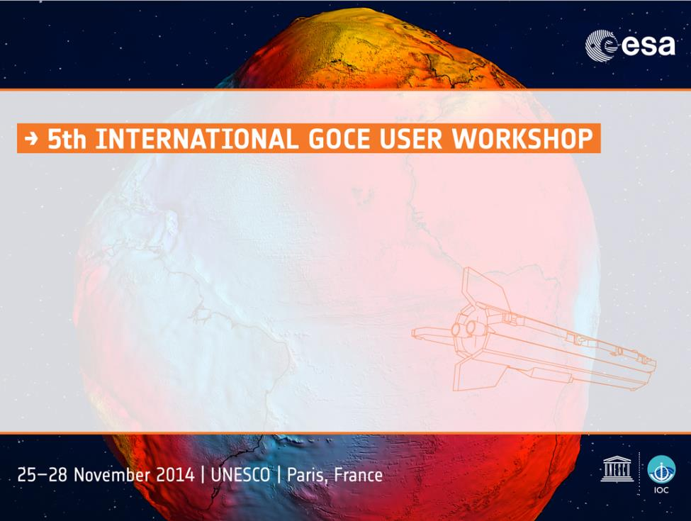

Evaluation of the Release-3, 4 and 5 GOCE-based Global Geopotential Models in North America
M. G. Sideris⁽¹⁾ , B. Amjadiparvar⁽¹⁾, E. Rangelova⁽¹⁾,
J. Huang⁽²⁾ , M. Véronneau⁽²⁾
(1) Department of Geomatics Engineering, University of Calgary
(2) Canadian Geodetic Survey, Surveyor General Branch

Slide 2
Outline
GOCE-based Global Geopotential Models (GGMs)
Evaluation by Degree Variances
Evaluation by GNSS-levelling Stations
Comparison against EGM2008
Impact on the gravimetric geoid
Conclusions
1

Slide 3
Global Geopotential Models (GGMs)
ESA’s High-level Processing Facility (HPF) GOCE-based GGMs
Model | Max DO | Data Source
DIR-R5 | 300 | 42 months of GOCE data and DIR4 as background model
TIM-R5 | 280 | 42 months of GOCE data
DIR-R4 | 240 | 28 months of GOCE data and DIR3 as background model
TIM-R4 | 250 | 26.5 months of GOCE data
DIR-R3 | 240 | 12 months of GOCE data and DIR2 as background model
TIM-R3 | 250 | 12 months of data
Objective:
To evaluate the performance of the models in North America
Motivation:
Important in view of the upcoming redefinition of the North American vertical datum through a continental geoid model using a GOCE-based GGM
2

Slide 4
Evaluation by Degree Variances (1/2)
The geoid height signal degree variances:
DO 220
DO 220
Square root of the signal degree variances for DIR and TIM models
3
Notes:
The signal degree variances show the signal content of the GGM in different spectral bands.
It can be said that the full signal of the Earth’s gravitational filed has been obtained solely from GOCE measurements up to DO 220 which corresponds to the spatial resolution of approximately 91 km.

Slide 5
Evaluation by Degree Variances (2/2)
Cumulative global geoid error:
GOCE mission’s goal:
1 - 2 cm geoid accuracy with 100 km spatial resolution
Cumulative global geoid error (cm)
0.8 cm
SH degree | TIM R3 | DIR R3 | TIM R4 | DIR R4 | TIM R5 | DIR R5
180 | 4.4 | 2.5 | 3.0 | 0.8 | 1.5 | 0.6
190 | 5.0 | 2.8 | 3.4 | 1.0 | 1.8 | 0.7
200 | 5.9 | 3.2 | 4.0 | 1.2 | 2.3 | 0.8
210 | 7.2 | 3.7 | 4.8 | 1.5 | 2.8 | 1.0
220 | 8.8 | 4.2 | 6.0 | 1.9 | 3.6 | 1.2
230 | 10.7 | 4.8 | 7.5 | 2.4 | 4.6 | 1.5
240 | 12.8 | 5.7 | 9.4 | 3.0 | 5.9 | 1.9
250 | 14.9 | --- | 11.3 | 3.7 | 7.4 | 2.3
4

Slide 6
GNSS-levelling Stations
Geoid height from GGM
Geoid height at the GNSS-levelling stations
5
Notes:
Canada:
1315 data points on the Canadian mainland with orthometric heights obtained by the Nov07 levelling adjustment are used for the evaluation of the GGMs in Canada. The Nov07 is one of the latest unofficial (scientific) vertical reference frames in Canada that provides orthometric heights for validation of the national gravimetric geoid models. Similar to NAVD88 (Zilkoski et al. 1992), this datum is constrained to the mean water level at Father Point/Rimouski, Québec, Canada. LS Adjustment if performed stepwise in order to take care of the systematic errors in the first order levelling network, including PGR.
Corrections for various systematic errors were applied to the levelling measurements in Canada and USA : refraction, rod calibration, magnetic field and astronomical (tidal) corrections.
The GNSS ellipsoidal heights come from the newest adjustment of the GNSS SuperNet network in Canada (Craymer and Lapelle, 1997) in ITRF2005, epoch 2006. The ellipsoidal heights were corrected for the effect of glacial isostatic adjustment of the Earth’s crust using a crustal velocity model developed by GSD.
NOTE: The systematic errors were modelled by a plane (one for all curves). The GGM used for the computation of the geoid heights is ggm05s to d/o 150, which is independent from any GOCE model.
There is no change in the max usable degree if a plane is fitted to and then removed from the geoids height differences.
USA:
The GNSS ellipsoidal heights are given in NAD83 (CORS96) 2002.0. The coordinates were transformed to ITRF2005 epoch 2006.0.
NOTE: The systematic errors were modelled by a plane (one for all curves). The GGM used for the computation of the geoid heights is ggm05s to d/o 150, which is independent from any GOCE model.
There is no change in the max usable degree if a plane is fitted to and then removed from the geoids height differences.
Alaska:
The GNSS ellipsoidal heights are given in NAD83 (CORS96) 2003.0 . The coordinates were transformed to ITRF2005 epoch 2006.0.
NOTE: The systematic errors were modelled by a plane (one for all curves). The GGM used for the computation of the geoid heights is ggm05s to d/o 150, which is independent from any GOCE model.
There is no change in the max usable degree if a plane is fitted to and then removed from the geoids height differences.
Mexico:
There is no information available about the horizontal frame of the ellipsoidal heights of these stations.
NOTE: The systematic errors were modelled by a plane (one for all curves). The GGM used for the computation of the geoid heights is ggm05s to d/o 150, which is independent from any GOCE model.
There is no change in the max usable degree if a plane is fitted to and then removed from the geoids height differences.

Slide 7
Systematic Levelling Errors
Standard deviation of the geoid height differences before and after plane fit (cm)
Region | Canada | CONUS | Alaska | Mexico
Before | 46.2 | 62.5 | 96.2 | 73.5
After | 41.8 | 52.4 | 94.4 | 70.7
6

Slide 8
Evaluation in Canada
  Region: Canada
  Datum/adjustment: Nov07
  Number of points: 1315
  Parametric model: A plane
  Max usable DO: 210
210
210
7

Slide 9
Evaluation in CONUS
  Region: CONUS
  Datum/adjustment: NAVD88
  Number of points: 18399
  Parametric model: A plane
  Max usable DO: 210
210
210
8

Slide 10
Evaluation in Alaska
  Region: Alaska of USA
  Datum/adjustment: NAVD88
  Number of points: 176
  Parametric model: A plane
  Max usable DO: 250
250
250
9

Slide 11
Evaluation in Mexico
  Region: Mexico
  Datum/adjustment: NAVD88
  Number of points: 744
  Parametric model: A plane
  Max usable DO: 280
280
280
10

Slide 12
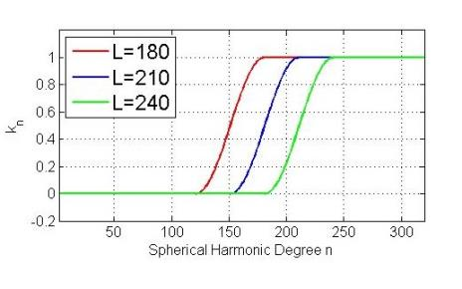
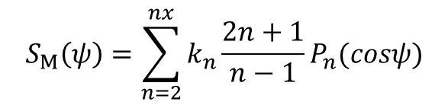
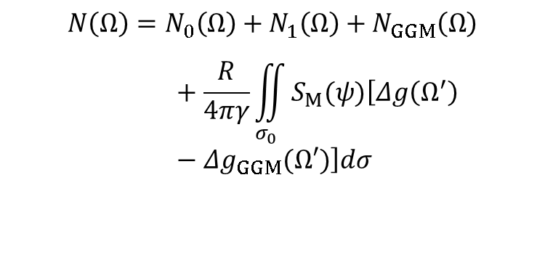
GOCE models’ impact on gravimetric geoid (1/4)
Remove-compute-restore scheme:
$$N\left(Ω\right)=N_{0}\left(Ω\right)+N_{1}\left(Ω\right)+N_{GGM}\left(Ω\right)+\frac{R}{4πγ}\iint_{σ_{0}}{S_{M}(ψ)\left[Δg\left(Ω^{′}\right)−Δg_{GGM}(Ω′)\right]dσ}$$
Modified Stokes’ function:
$$S_{M}\left(ψ\right)=\sum_{n=2}^{nx}{k_{n}\frac{2n+1}{n−1}}P_{n}(cosψ)$$
Modification degree: L
11

Slide 13
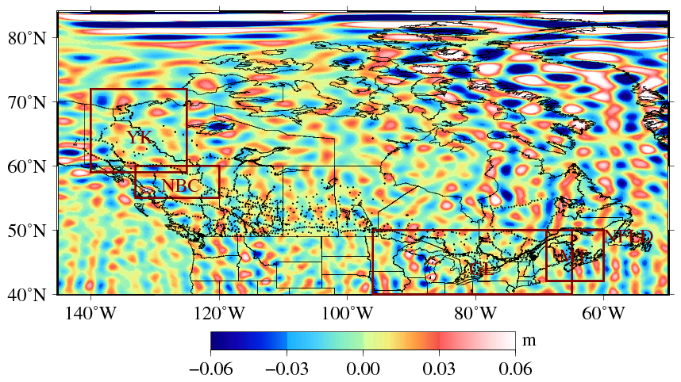
GOCE models’ impact on gravimetric geoid (2/4)
Geoid differences between
M036 (Terrestrial data+DIR_R5+L210) and
CGG2013 (Terrestrial data + EIGEN-6C3stat+L180)
12

Slide 14
GOCE models’ impact on gravimetric geoid (3/4)
GNSS-levelling comparisons for release 4 and 5 of DIR models
13
Notes:
For DIR-R4 and -R5, improvement is seen all the regions except for Northern British Columbia.
One surprising result is found in Newfoundland where the R5 is poorer than R4. A preliminary look suggests the striping error in GRACE may cause this problem.

Slide 15
GOCE models’ impact on gravimetric geoid (4/4)
GNSS-levelling comparisons for release 4 and 5 of TIM models
14
Notes:
Improvement over CGG2013 is seen in Canada, the Great lakes and the Maritimes, while not seen over the other three regions.

Slide 16
Conclusions
The error degree variance analysis of RL05’s models indicates that GOCE has achieved its mission goal.
Better performance of the release 5 models than the previous releases. Larger amount of GOCE measurements and the low orbit mission data.
Release 5 models brought slight improvement over EGM2008 in Canada and CONUS.
Considerable improvement over EGM2008 was brought by release 5 models to Alaska and Mexico.
The impact of the release 5 models on gravimetric geoid was observed. Overall, the gravimetric geoid model based on the release 5 of the DIR model performs better than the CGG2013 model.
The release 5 of the DIR model up to DO 210 is suggested to be used for the geoid computations in Canada.
15

Slide 17
Thank you for your attention
"This work was a contribution to the ESA STSE – GOCE+ Height System Unification with GOCE project."
16

