Slide 1
MWR vs. AIRWAVE TCWV
Preliminary results
Stefano Casadio ESA/EOP-GMQ

Slide 2
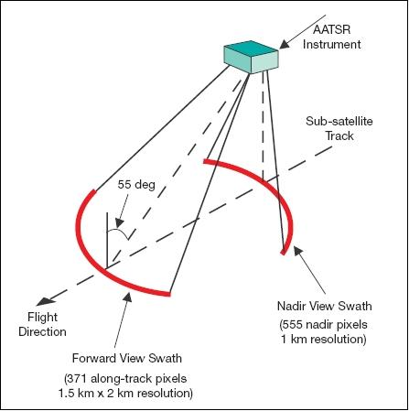
AIRWAVE basics (I)
ATSR-1 (1991-1996, ERS-1)
ATSR-2 (1995-2003, ERS-2)
AATSR (2002-2012, ENVISAT)
Pros
Dual view capability (0° and 55°)
Stable orbit tracks (ANX 10:00pm, 10:30pm)
TIR channels calibrated on-board (BB)
Relatively high spatial resolution (1x1 km²)
Same instrumental setup
Cons
Small swath (500 km across track)
Only 10.8 and 12 µm BTs always available (+SWIR)

Slide 3
AIRWAVE basics (II)
Dual view exploitation: linear combination of NADIR and FORWARD pseudo-columns Φ to get rid of “unknown” atmosphere/surface contribution (called “G”)
The combination parameters α, β, and δ can be calculated using RTM
All contributions are well separated and can be analysed/evaluated/updated independently from each other

Slide 4
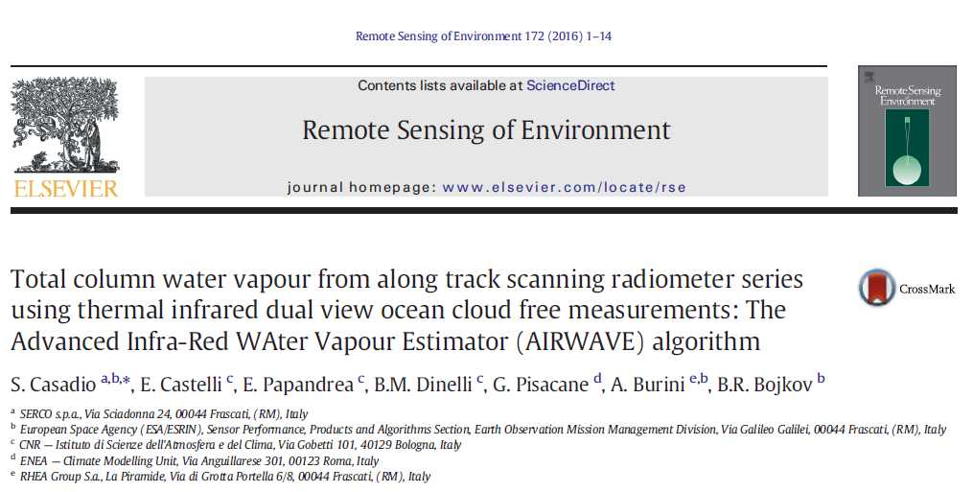

Slide 5
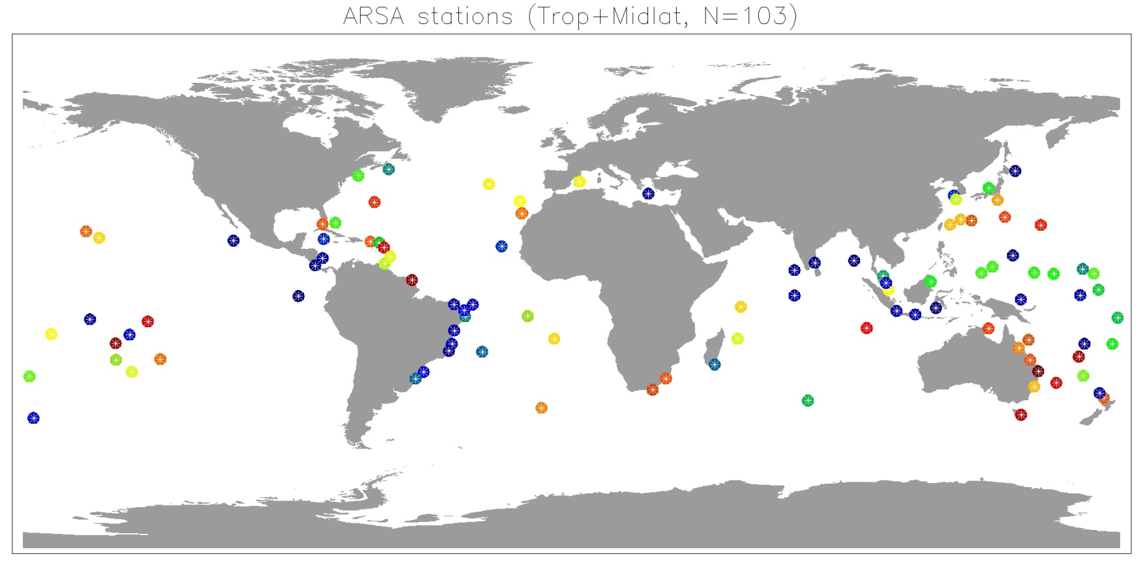
AIRWAVE vs. SONDES (ARSA db)
Selection criteria:
Close to coast: 70% of sea in an area of 1x1 deg, AVHRR land/sea mask
More than 100 ATSR-sonde collocations

Slide 6
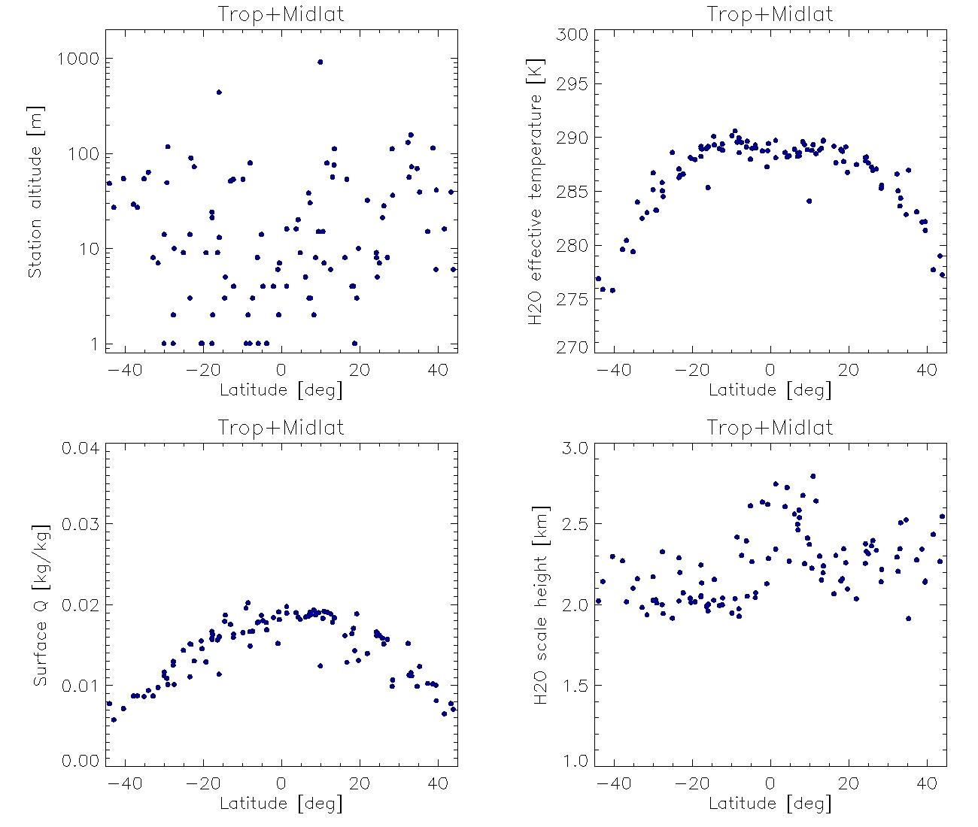
AIRWAVE vs. SONDES (ARSA db)

Slide 7
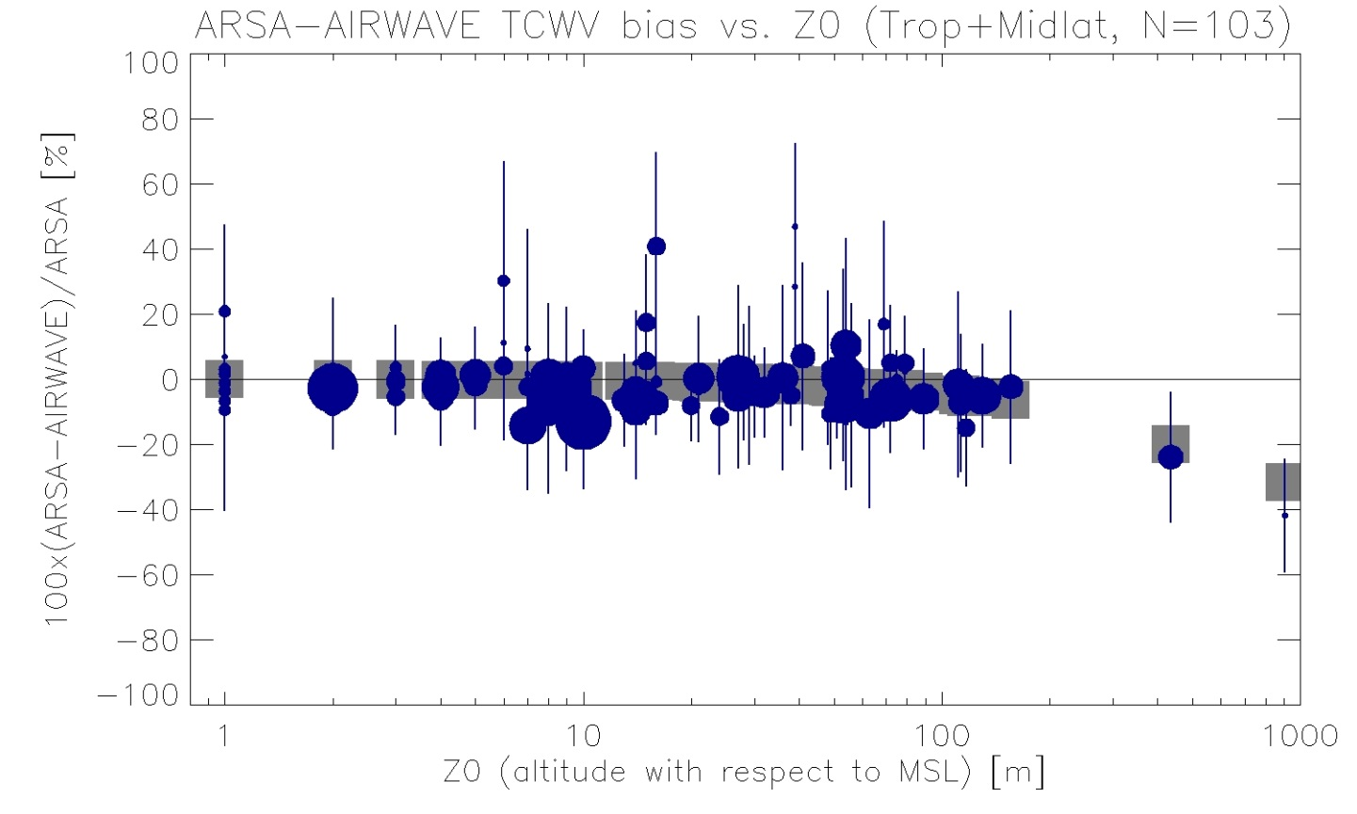
AIRWAVE vs. SONDES (ARSA db)
Bias due to sounding’s start altitude with respect to MSL
Circle radius ≈ num data
Vertical bar: RMSE
Square: “missing” TCWV
100.0*(exp(-H/Hscl) -1.0)
H = sounding’s start altitude
Hscl = H2O scale height

Slide 8
AIRWAVE vs. SONDES (ARSA db)

Slide 9
MWR vs. AIRWAVE (I)
Collocation criteria: 20km distance from MWR pixel centre
Statistics of AIRWAVE data (MWR pixel):
Number of samples (i.e. cloud coverage)
Mean lat/lon
Mean+std TCWV (cloud free)
Day/night flag and orbit number
Clusters of cloud/nocloud AIRWAVE data (cloud type)
Pointer to RA-MWR data

Slide 10
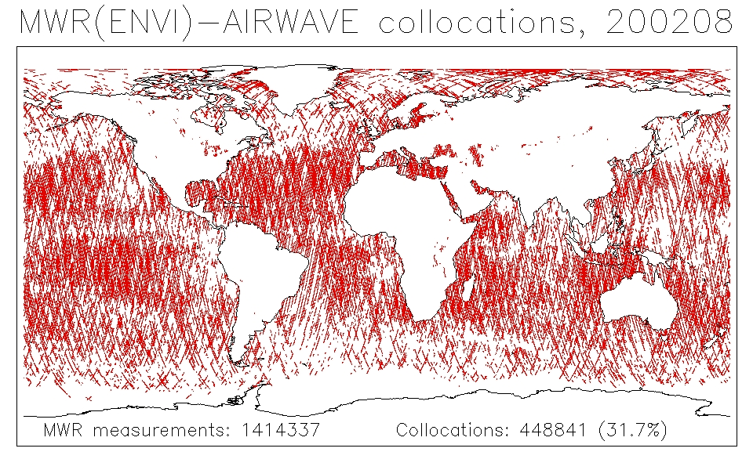
MWR vs. AIRWAVE (II)

Slide 11
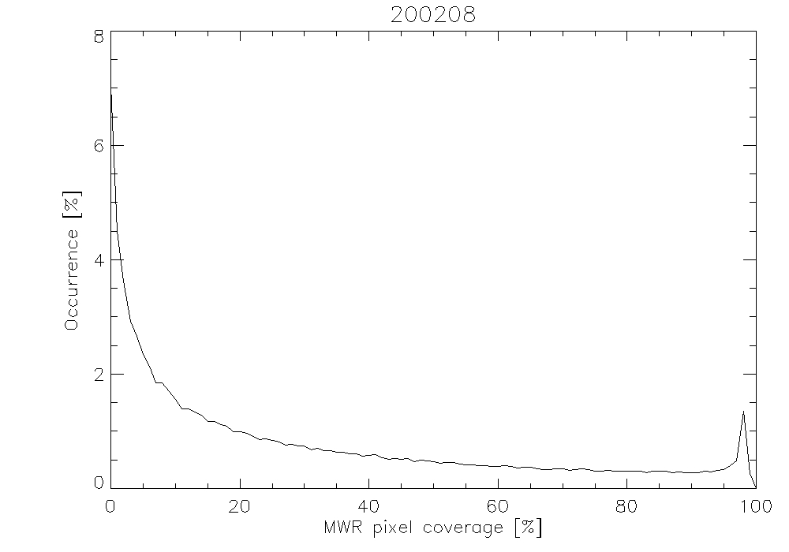
MWR vs. AIRWAVE (III)

Slide 12
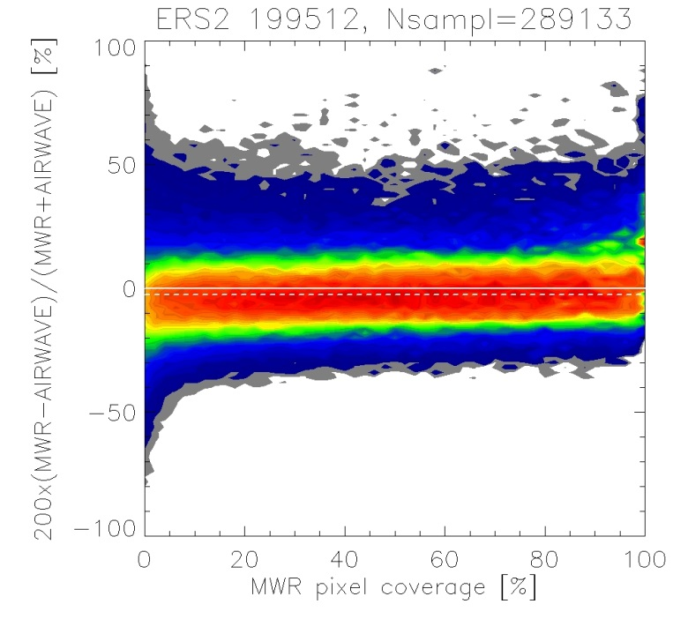
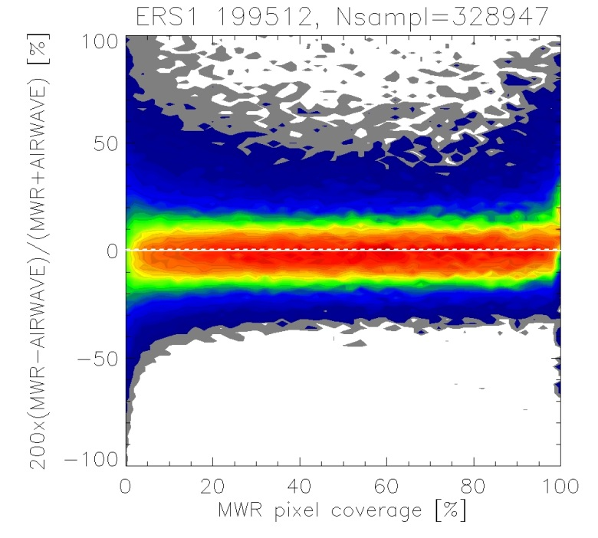
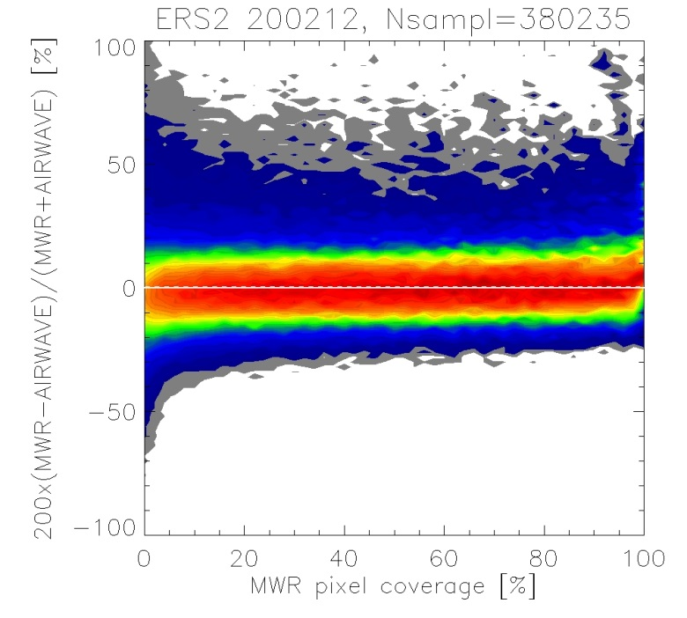
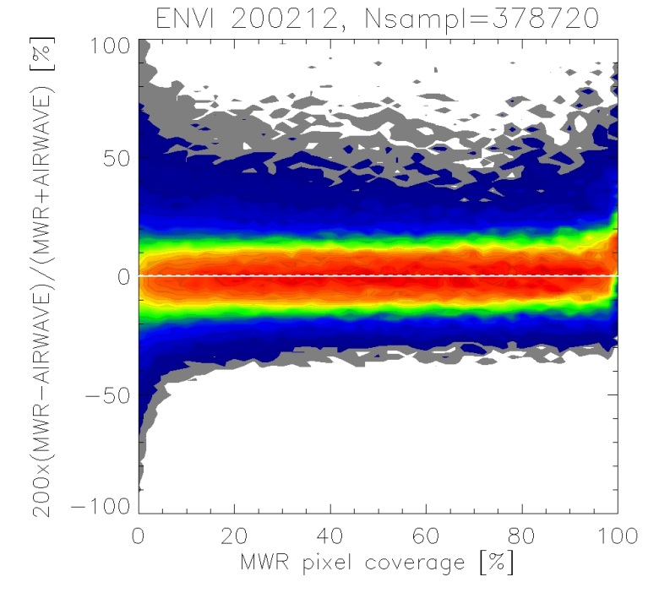

Slide 13
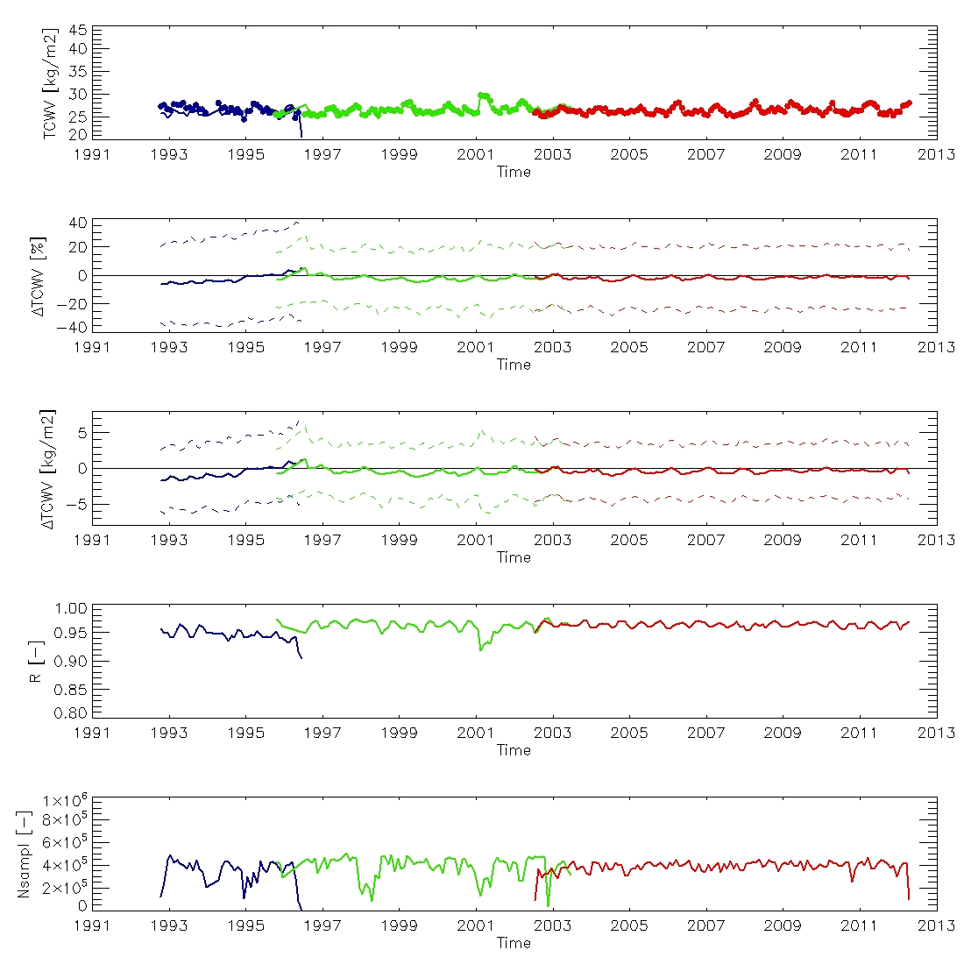
90S<Lat<90N
MWR PIXEL COVERAGE >0%

Slide 14
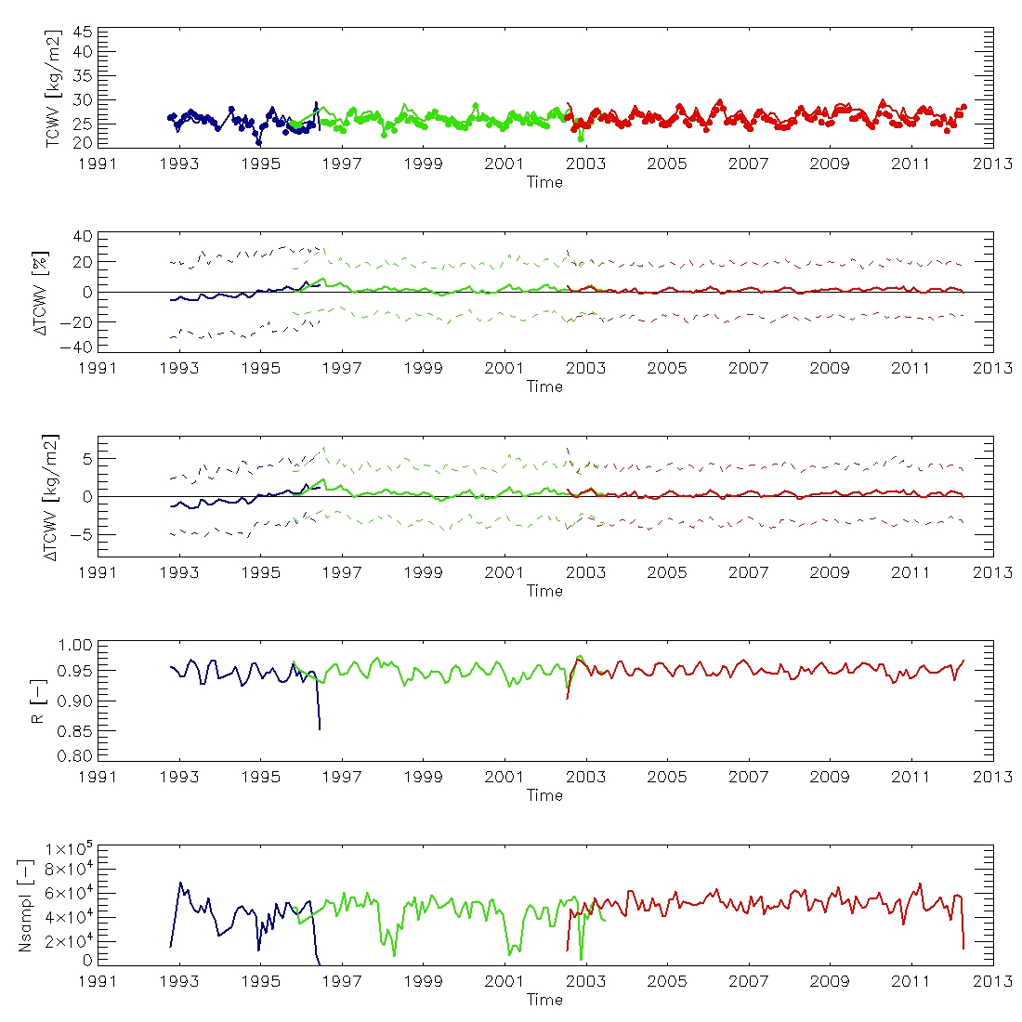
90S<Lat<90N
MWR PIXEL COVERAGE >70%

Slide 15
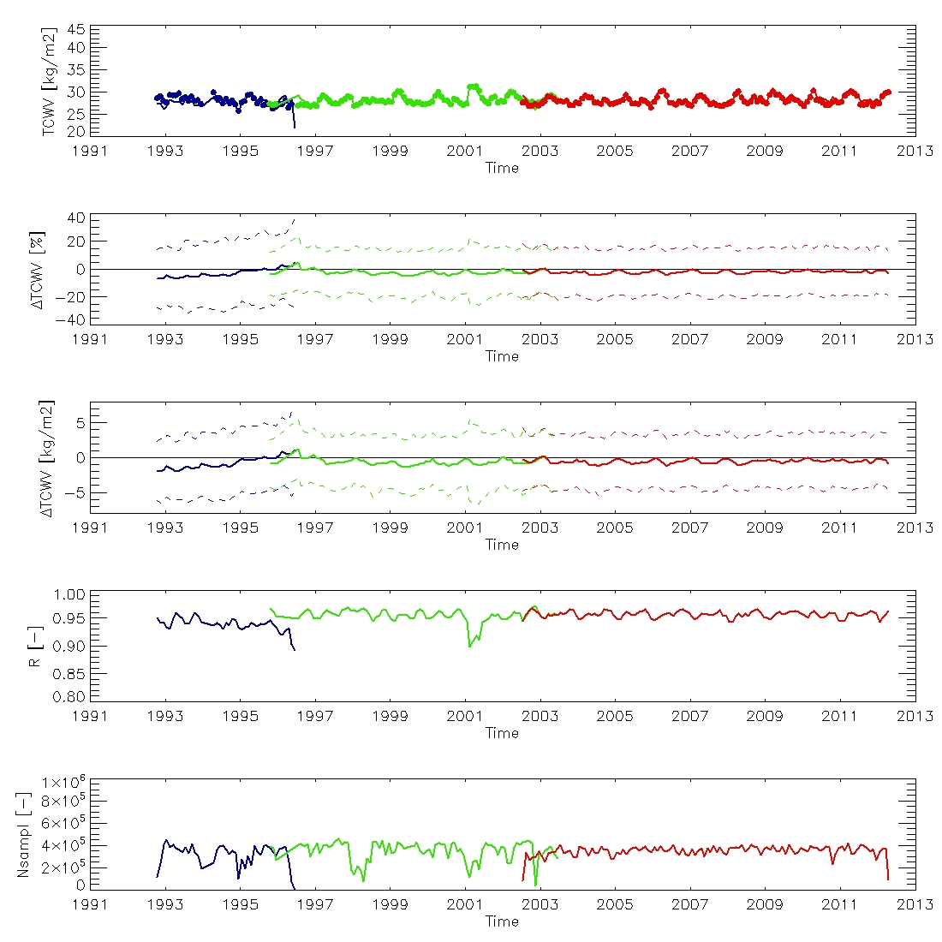
50S<Lat<50N
MWR PIXEL COVERAGE >0%

Slide 16
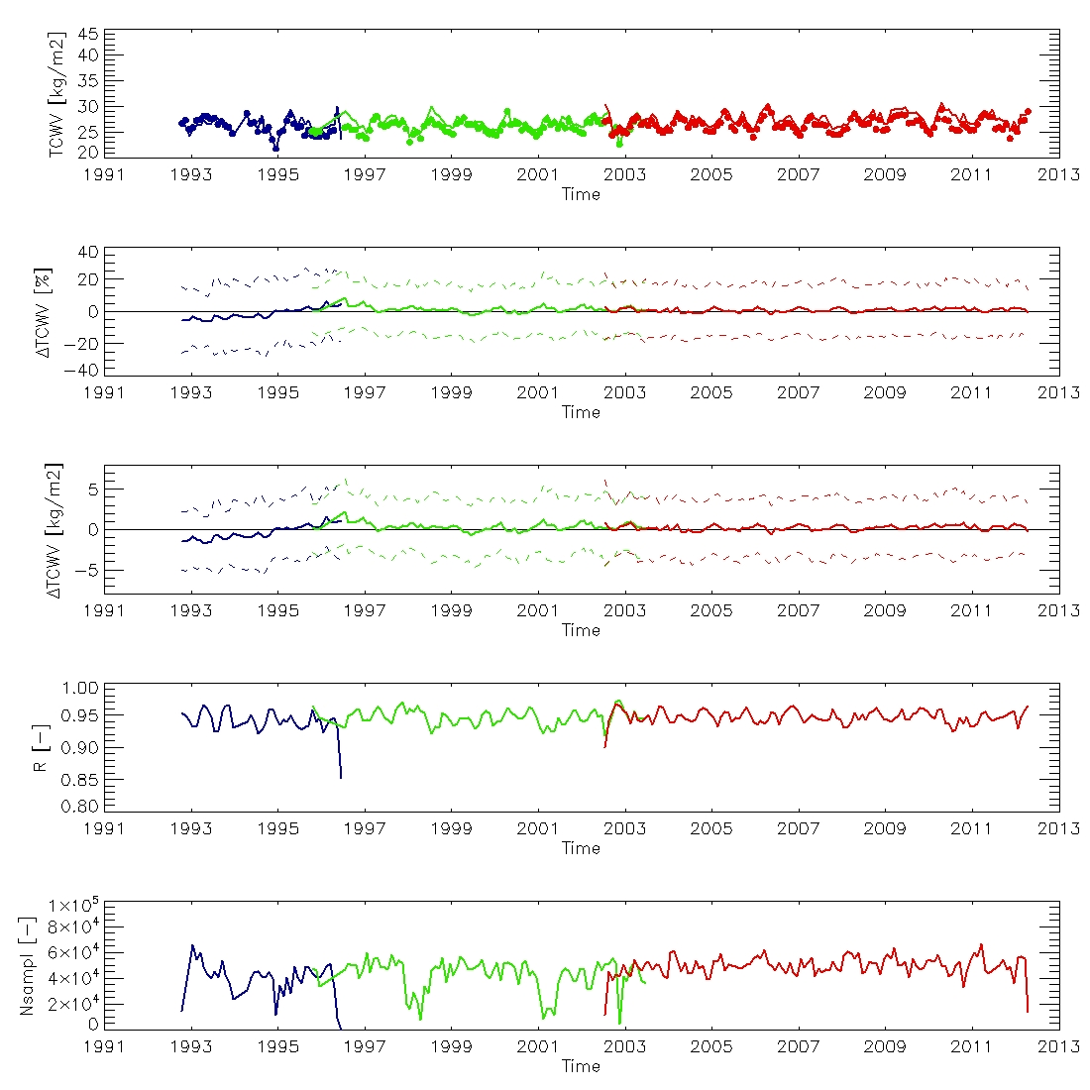
50S<Lat<50N
MWR PIXEL COVERAGE >70%

Slide 17
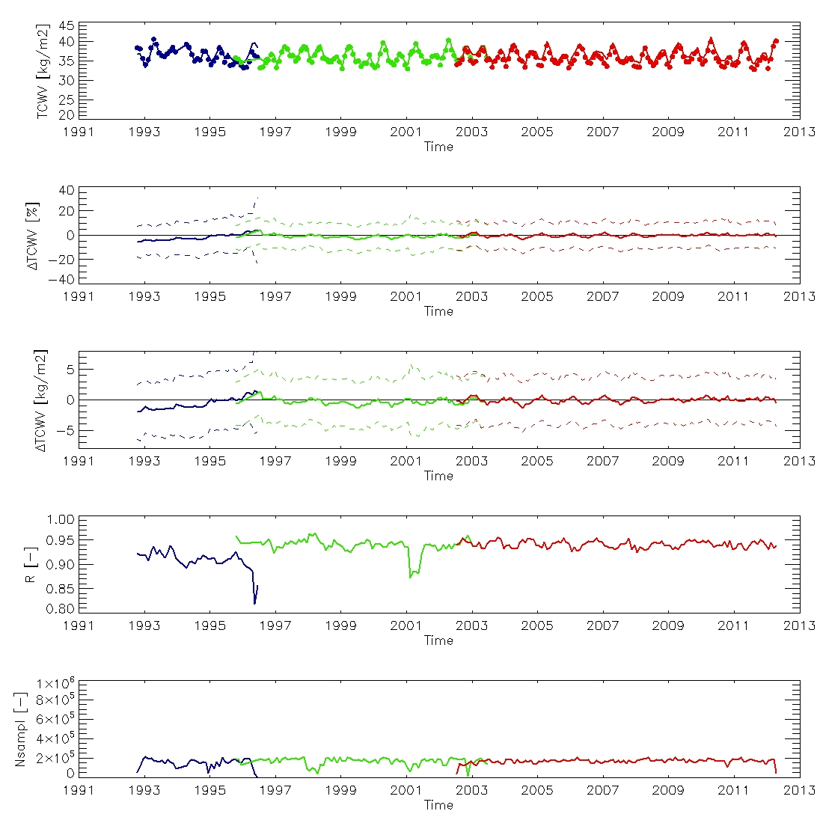
20S<Lat<20N
MWR PIXEL COVERAGE >0%

Slide 18
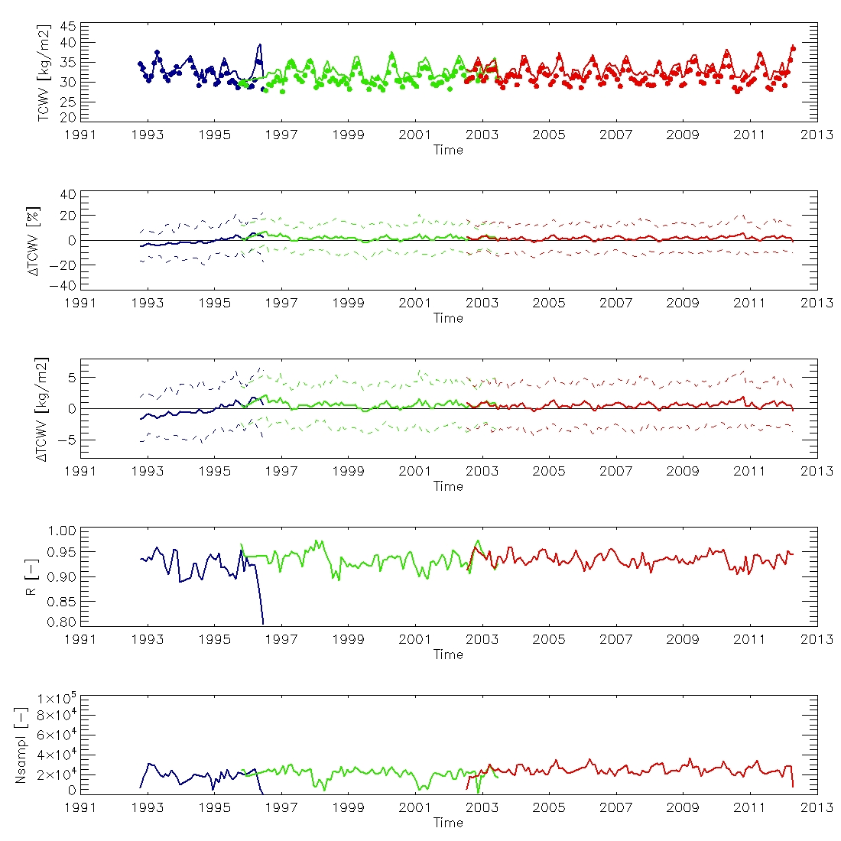
20S<Lat<20N
MWR PIXEL COVERAGE >70%

Slide 19
Preliminary Conclusions
Comparison of TCWV (cloud free)
Totally independent techniques (MW vs. TIR)
1992-2012 (ERS-1, ERS-2, ENVISAT)
Negligible bias (small trend for ERS-1)
Stable RMSE (higher for ERS-1)
High correlation coefficient
Very good results, much more work to do

